Slide 1
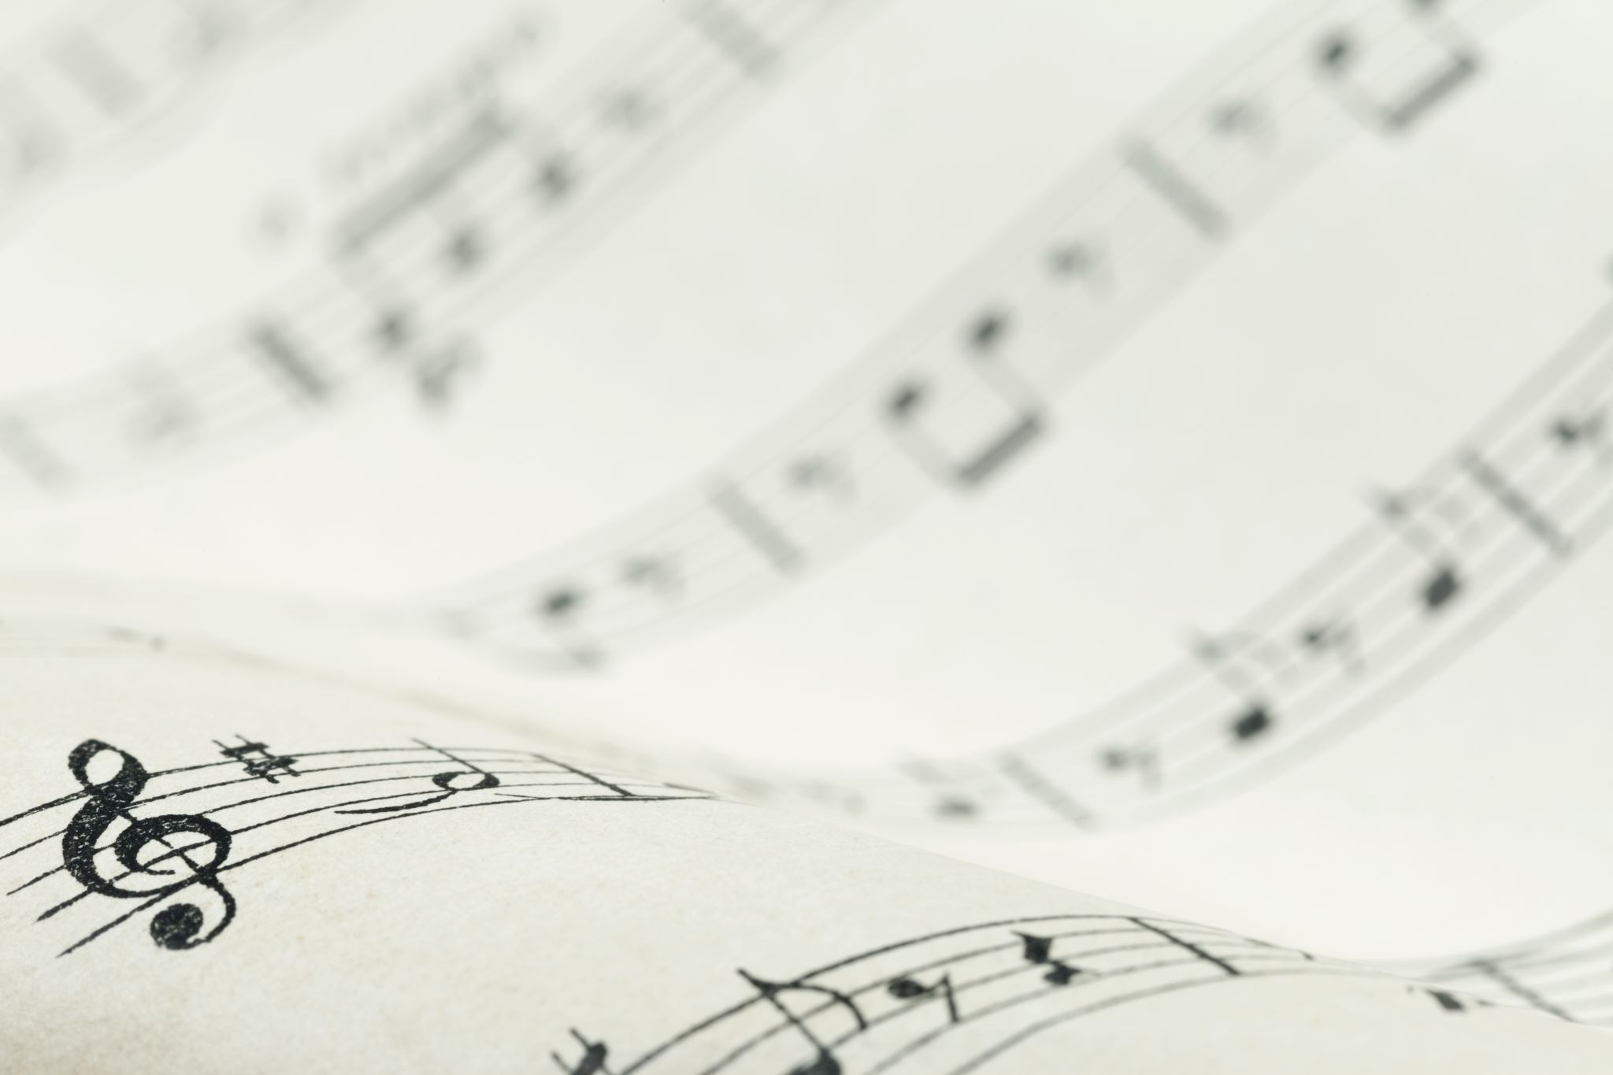
Representing Musical Information
MUS 4745

Slide 2
What is Musical Data?
Notes
Pitch, dynamics, duration
Instrument
Timbre, range, color, location

Slide 3
What is Musical Data?
Time-variant information
Phrasing, crescendo/decrescendo
Tempo, articulations
Information that ties multiple notes together
Language information
Lyrics
Stage directions
Meta information
Composer, year of composition, instrumentation

Slide 4
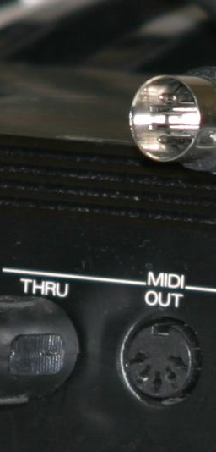
What is MIDI?
Musical Information Digital Interface
Hardware specification for interface devices
Standard communication protocol for musical information
Standard storage format for data
This Photo by Unknown Author is licensed under CC BY-SA

Slide 5
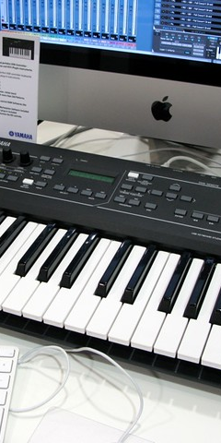
Why use MIDI?
Sending control messages from musical instrument analogs (keyboards, percussion, wind controllers) to synthesizers and computers
Recording and playback of musical performance
This Photo by Unknown Author is licensed under CC BY-NC-ND

Slide 6
Why not MIDI?
Not a complete representation of musical information
It only represents musical performance information
Does not address musical meta- or global information
It is NOT a medium for digital audio

Slide 7
Why MIDI?
A little history of digital instruments in necessary
Analog Synthesizers (1960s-70s)
Moog, Roland, Oberheim
Voltage-controlled oscillators, amplifiers
Late 1970s - Early 1980s
Digital control of analog synthesizers
Sequential Circuits (Prophet 5), Korg, Roland, Oberheim, Yamaha
Interoperability was a problem
CV values for each manufacturer were different

Slide 8
Why MIDI?
Digital Synthesizers were on the way!
Yamaha DX7 released in 1983
First mass-produced digital synthesizer
Most successful synthesizer EVER!
Everybody else tried to compete
Casio, Oberheim, Korg, Kawai, Prophet, Akai, Ensoniq

Slide 9
Why MIDI?
Economic Pressure
Musicians wanted to connect synths together so you could play one of many synths with one keyboard
Manufacturers had proprietary communication systems
You had to buy all your synths from the same manufacturer
Competitive pressure on instrument manufacturers drove the collaboration
Universal Synthesizer Interface…

Slide 10
Why MIDI?
1982
Roland, Yamaha, Kawai, Korg, Sequential Circuits agreed to collaborate on a method to connect their devices
1983
Published Musical Instrument Digital Interface (MIDI)
Designed for communication between instruments of different manufacturers
Demonstration of connected devices at the Jan 1983 NAMM show

Slide 11
Why MIDI?
1984 - Macintosh computer
1985 - MIDI protocol
people realized that computers could “read” MIDI data
new kind of music software - the “sequencer”

Slide 12
Why MIDI?
MIDI Sequencers
Read, write, playback MIDI data in time synchronous fashion
Tape deck metaphor
In late 1980s, computer chips became fast enough to handle real-time digital audio
Digital audio recording and editing apps
By late 1990s, DAR and MIDI apps merged

Slide 13
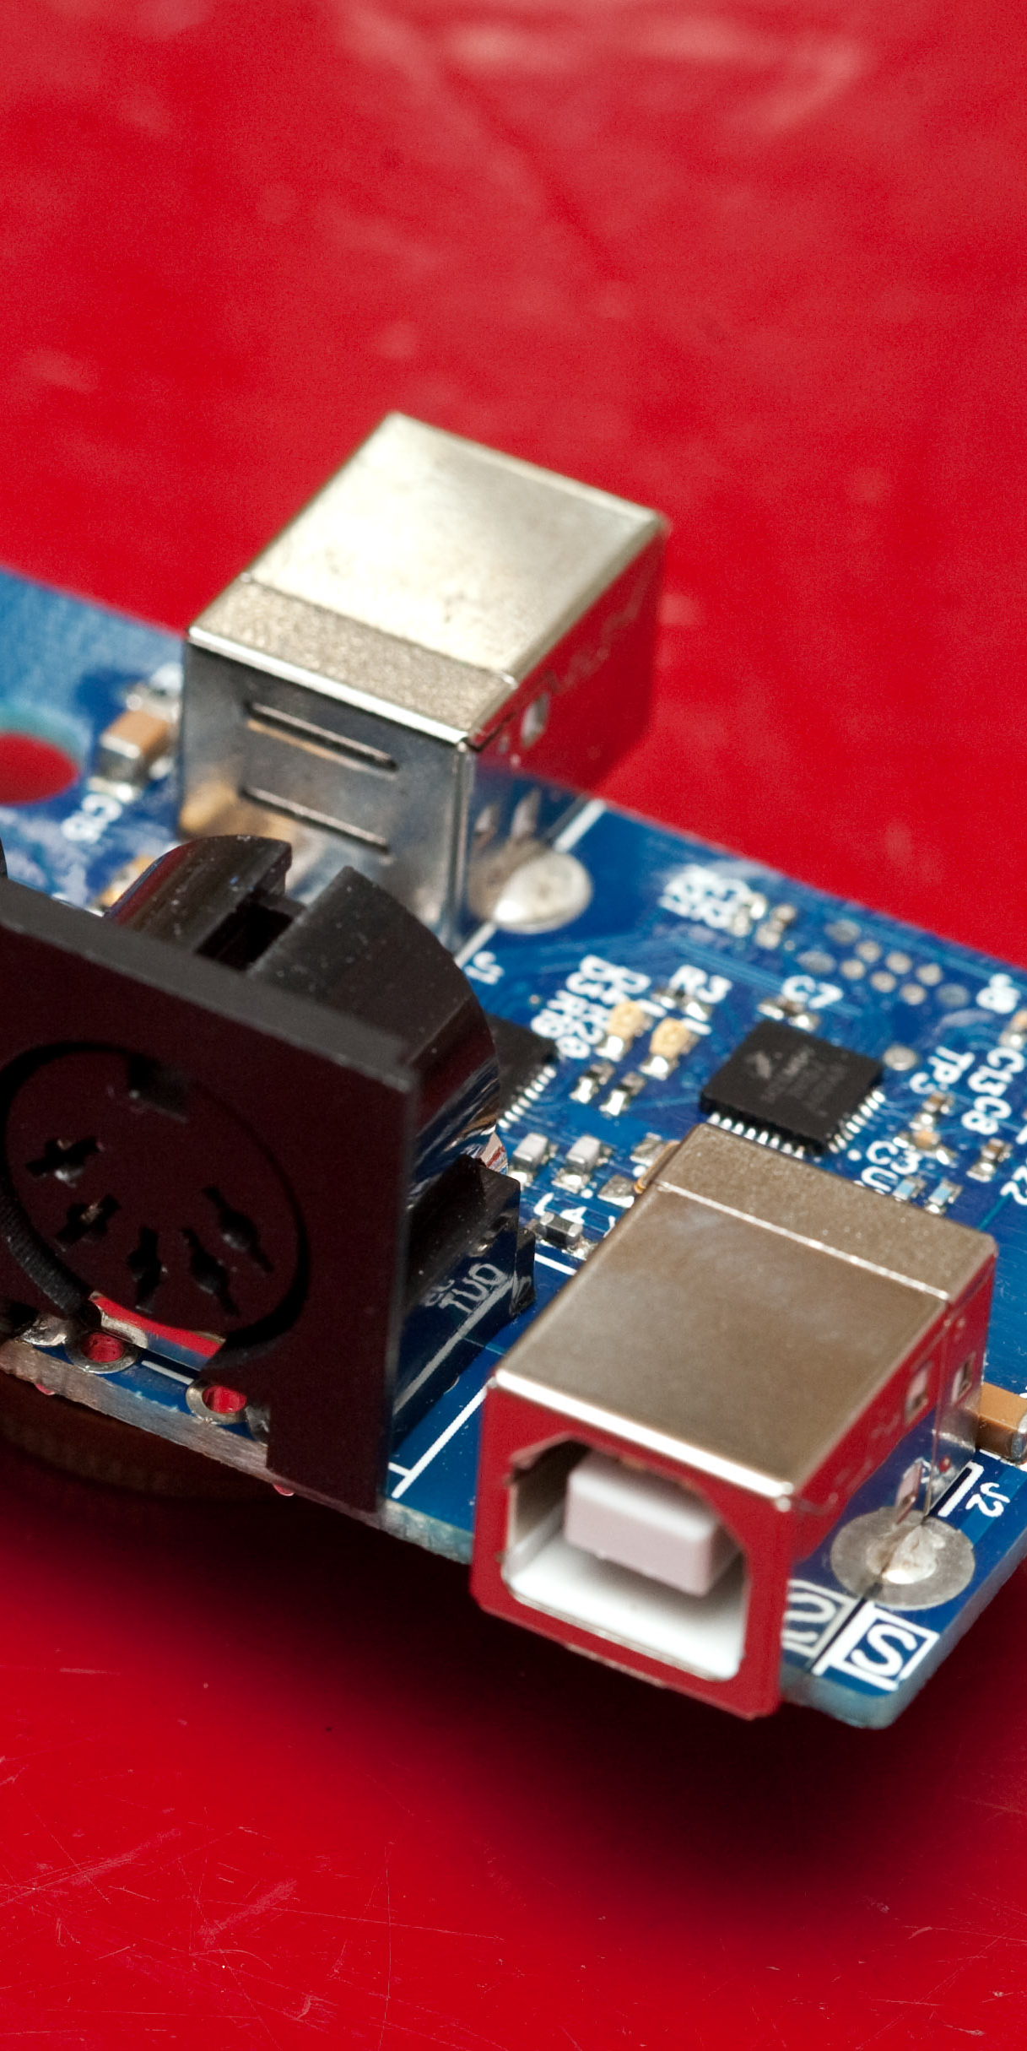
MIDI Hardware
Hardware specifications
Uni-directional communication
MIDI In, MIDI Out, MIDI Thru
DIN 5-pin connections
31,250 kbits / second
This Photo by Unknown Author is licensed under CC BY-SA

Slide 14
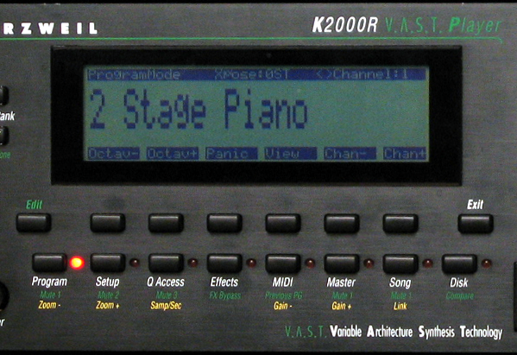
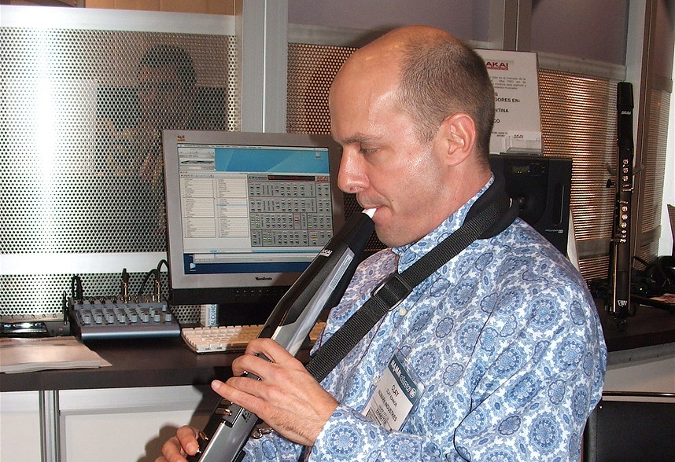
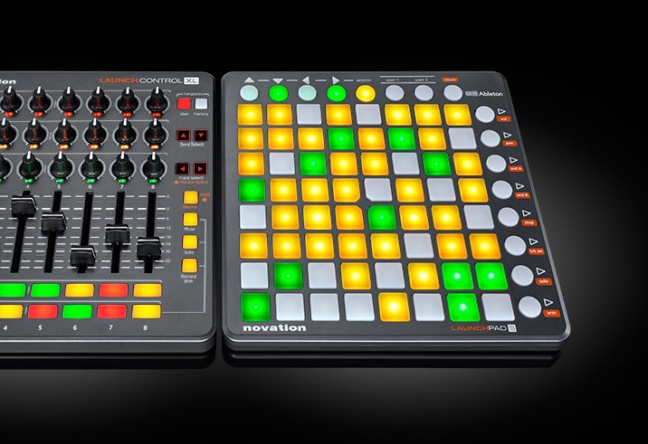
MIDI Hardware
This Photo by Unknown Author is licensed under CC BY-SA
MIDI Interfaces
MIDI Controllers
Keyboards, Wind Controllers, Percussion controllers
Non-traditional controllers (gloves, theremin)
MIDI Synthesizers
This Photo by Unknown Author is licensed under CC BY-NC
This Photo by Unknown Author is licensed under CC BY-SA

Slide 15
Bits & Bytes
Bits
Bits are binary digit spaces (0 or 1)
Byte
a single piece of data (datum)
Each byte is sized by the number of bits
8-bit datum can represent 256 states (2^8)
16-bit datum can represent 65,536 states (2^16)

Slide 16
MIDI Protocol
8-bit data structure
Standardized set of “message” types
Note On
Note Off
Continuous Controller
Program Change
Each message type consists of one, two or three bytes

Slide 17
MIDI Protocol
Messaging is best represented in Hexadecimal (base 16)
Base 16
0, 1, 2, 3, 4, 5, 6, 7, 8, 9, A, B, C, D, E, F
Use $ or 0x as prefix
$90 = 1001 0000 = 2^7 + 2^4 = 128 + 16 = 144

Slide 18
MIDI Messages
MIDI messages contain a status byte (or command byte) and data byte(s)
Status bytes have two components
MSB = MIDI Command
LSB = MIDI “channel”
Generic message structure is:
$command-channel $data1 $data2
1001 0000 = 9 => MSB
1001 0000 = 0 => LSB
$90 => NoteOn, channel 1

Slide 19
Note On
Note On - $9x $kk $vv
x = channel number
kk = MIDI key (0 - 127)
Middle C = 60
vv = Velocity (0 - 127)
Velocity 0 => silent

Slide 20
Note Off
Note Off - $8x $kk $vv
x = channel number
kk = MIDI note number
vv = velocity
assumed to be zero, usually ignored

Slide 21
Aftertouch
Aftertouch = $Ax $kk $vv
x = channel number
kk = key number
vv = velocity

Slide 22
Continuous Control
Control change = $Bx $cc $vv
x = channel number
cc = controller (0 - 119)
vv = control value
Used to change synthesis parameters during execution (i.e. vibrato, timbre shift)

Slide 23
Program Change
Program Change = $Cx $pp
x = channel number
pp = program number
Recall saved synthesis patch to synthesizer

Slide 24
Pitch Bend
Pitch bend = $Dx $aa $bb
14-bit number up or down
$aa = least significant byte ($00 - $EF)
$bb = most significant byte ($00 - $EF)
Pitch bend value = $bbaa

Slide 25
System Exclusive
System Exclusive
End of Exclusive Message
Sends manufacturer-specific information to the synthesizer

Slide 26
Real-time Messages
Timing Clock - $F7
24 times per quarter note when in synch mode
Active Sensing - $FE
sent up to 300 ms apart
Reset - $FF
Return all values to zero

Slide 27
MIDI & Csound
MIDI is a universal protocol and can be used with Csound
Csound can
Read MIDI files to control its virtual synthesizers
Use MIDI representation as score values
Send MIDI information to other applications or off-board synthesizers (but why?)

